Slide 1

Quantum-Dot-Based Optical Fingerprinting System for Product Authentication : ‘Q-D based Authenticator’
(24) IoT and Sensors

Slide 2
Q-D based Authenticator
TEAM ECOFLUX
Anirban Biswas
Mentor/Guide
Dr. Anjaneya
Basavarajeshwari
Ratna Sree K
Rohan Kachrola
Vaishnavi Agrawal

Slide 3
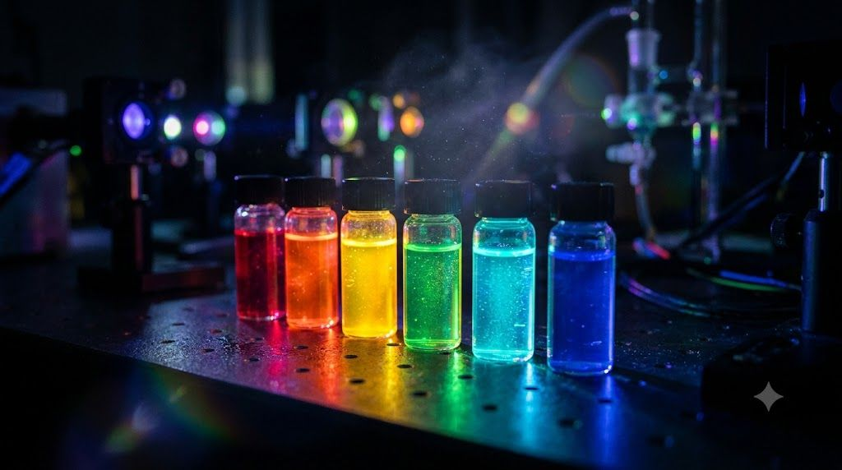
EL Phase-I
Presentation Outline
Introduction
Problem Definition
Literature Review & Research Gap
Objectives
Methodology
Proposed Outcomes
Timeline
Conclusion
References

Slide 4
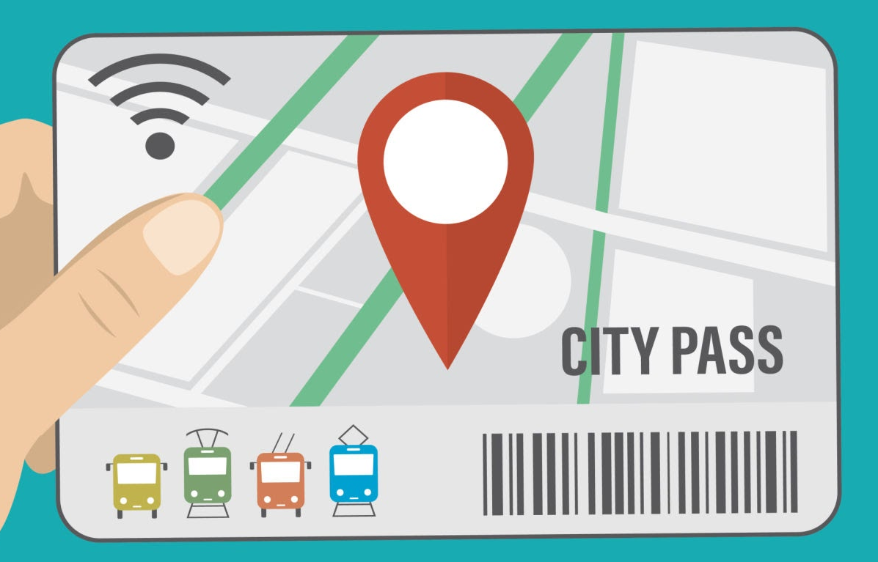
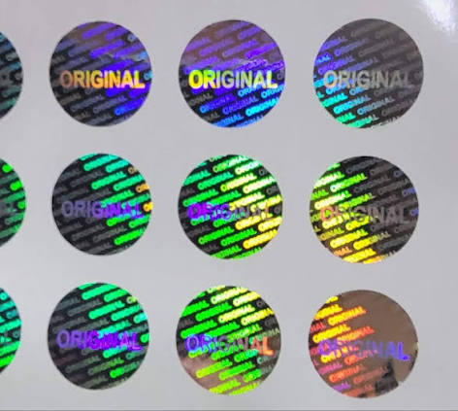
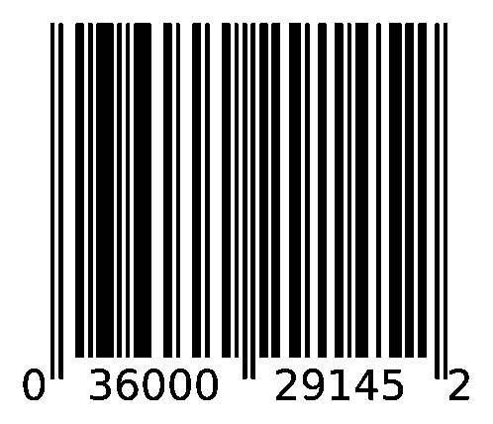
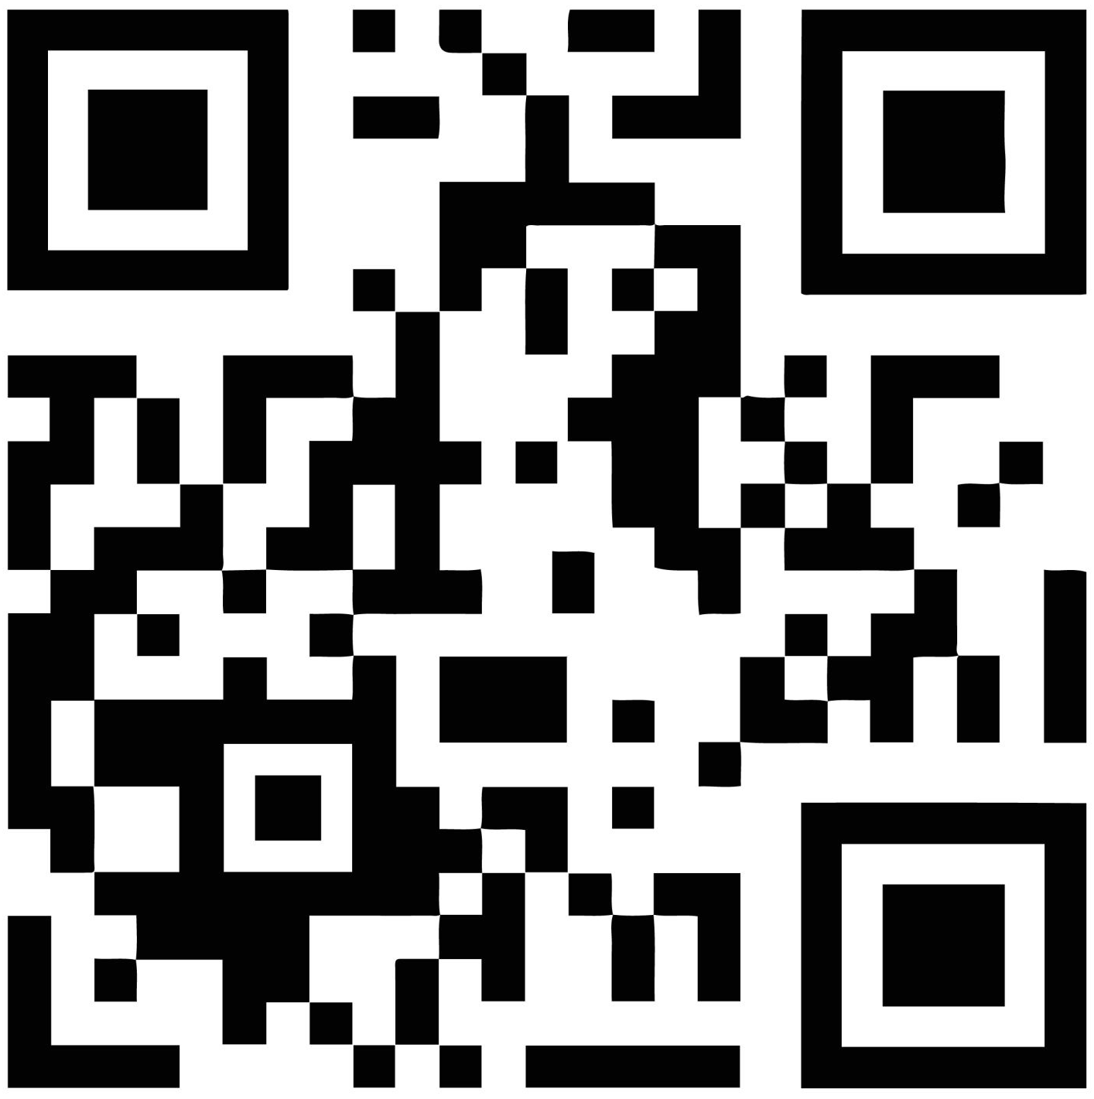
Introduction
Companies lose billions of dollars every year when cheap, fake copies of their products enter the store shelves.
Counterfeit items like fake medicines/faulty tech parts can cause a lot of harm and customers may lose total trust in the original brand and stop buying from them.
Hence, businesses need a reliable method to identify their authentic products and track them securely across the supply chain : Organizations currently rely on conventional tracking tools like barcodes, QR codes, RFID tags, and holographic labels embedded on packaging.
Notes:
Rajeshwari

Slide 5
Problem Definition
However, these static technologies FAIL to provide absolute security, leaving them highly susceptible to sophisticated replication or tampering.
Easy to Clone: QR codes, printed serial numbers and other visible identifiers can be copied and reproduced using high resolution photography/ digital printing, making it difficult to distinguish authentic products from counterfeits.
Cost vs. Security Trade-off: Advanced security features, such as specialized holograms and security packaging, can increase production costs while still having limitations against replication.
Core Vulnerability: A valid code or identifier confirms the identity it represents but does not necessarily prove that the physical tag attached to the product is original. It can be peeled off and re-stuck onto fake products.
THE CORE CHALLENGE : Can we build a low-cost identification marker that is unique to each tag, tied to physical object, and difficult to copy.
Notes:
Rajeshwari

Slide 6
Literature Review
1. Liu et al. (2019), Nature Communications
Developed quantum-dot fluorescent security labels authenticated using microscopic imaging and AI.
Limitation: Uses an imaging-based authentication approach rather than our proposed RGB sensor reader.
2. Muthamma et al. (2021), Applied Materials Today
Reviewed carbon-dot synthesis, fluorescence properties and security-ink applications.
Limitation: Fluorescence-colour-based verification alone may not provide sufficient security.
3. Carbon Dots for Forensic Applications: A Critical Review (2020), Nanomaterials
Reviewed carbon-dot security inks, optical encryption and anti-counterfeiting applications.
Limitation: Measurement standardization, repeatability and integration into automated systems remain important considerations.
4. Fong et al. (2022), Scientific Reports
Demonstrated quantum-dot tag authentication using photoluminescence measurements at different excitation powers.
Limitation: Does not validate the specific low-cost RGB sensor and ESP32 configuration proposed here.
Research Gap
Existing studies show that quantum dots can make anti-counterfeit labels, but each has some drawback: Reading them needs AI/microscope, measurements aren’t standardized, aren’t easy to put into automated systems and a low-cost RGB sensor + ESP32 hasn’t been tested.
Notes:
Vaishnavi

Slide 7
Objectives
Main objective: Build and evaluate a low-cost optical authenticator that reads CQD tag and verifies it using digital fingerprint comparison.
Specific objectives:
1. Prepare: Prepare or identify a suitable CQD sample and fabricate UV-glowing tags that can be pasted on product packaging.
2. Measure: Capture at least 10 repeated RGB readings (including intensity) per tag under controlled UV LED conditions.
3. Register: Create and store a numerical reference profile for each registered tag using the measured values.
4. Evaluate: Quantify measurement repeatability, and test whether genuine tags can be told apart from non-matching or imitation samples (for example, ordinary fluorescent dye) using a predefined decision threshold.
5. Demonstrate: Integrate the sensor with the ESP32 to display MATCH / NO MATCH on the OLED by the final project evaluation.
Expected contribution: Testing whether an affordable UV LED + RGB sensor + ESP32 setup can support a useful, low-cost physical-digital tag identity compared with holograms and security packaging.
Notes:
Vaishnavi

Slide 8
The Carbon Quantum Dot
1. What are CQDs?
Carbon Quantum Dots (CQDs) are tiny carbon-based nanoparticles, generally less than 10 nm in size. They exhibit unique optical properties, including fluorescence, meaning they can emit light when excited by a suitable light source.
2. Preparation of CQDs
Dissolve citric acid and urea in distilled water to prepare a uniform solution.
Heat the solution using microwave-assisted synthesis protocol.
Allow the reaction mixture to cool safely.
Filter or centrifuge the mixture to remove larger particles and impurities.
Purify the resulting solution, using dialysis if required, to remove unreacted chemicals and small by-products.
Test the purified solution under a suitable UV light source to check for fluorescence.
Notes:
Anirban

Slide 9
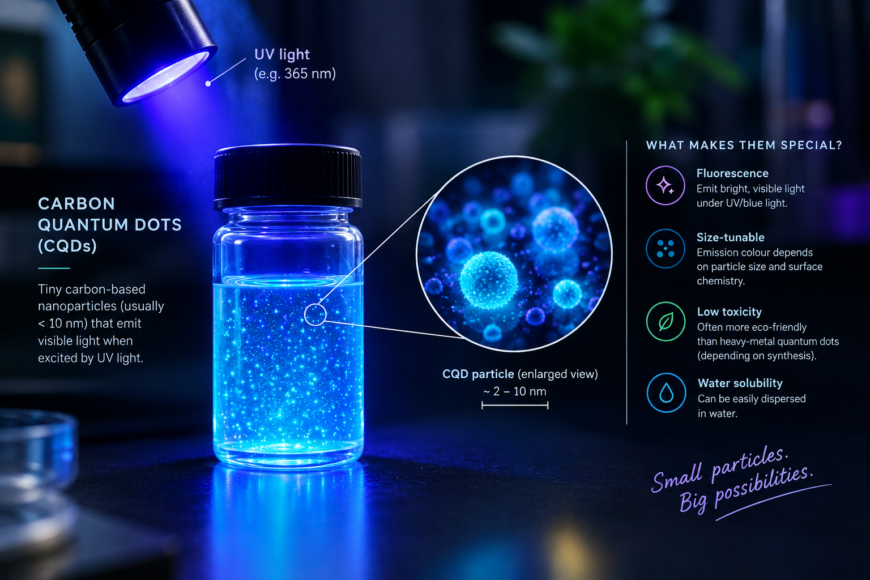
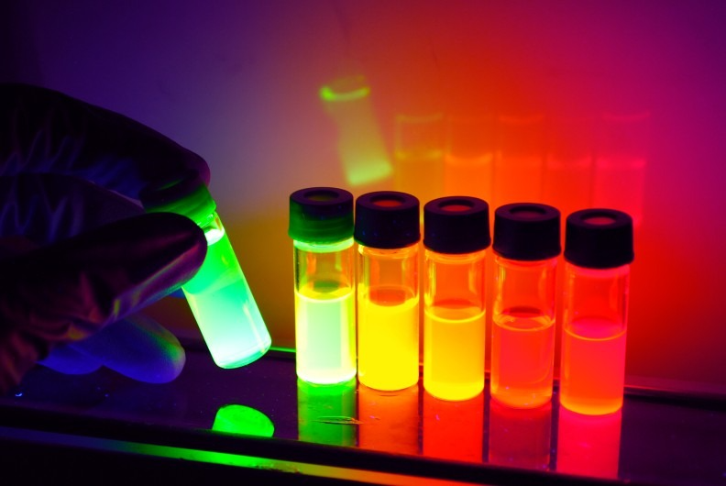
3. Role of CQDs in Our Project
In our Quantum-Dot-Based Optical Fingerprinting System for Product Authentication, CQDs act as a fluorescent security marker. The 365 nm UV light excites the CQD particles causing it to emit visible light captured later by RGB sensor.
Notes:
Anirban

Slide 10
Hardware and Materials
• 365 nm UV LED: Provides excitation light to stimulate fluorescence from the carbon quantum dots.
• TCS34725 RGB Sensor: Measures the emitted light's red, green, and blue channel responses.
• ESP32 Microcontroller: Collects sensor readings, processes optical features, and manages the system's operation.
• 0.96-inch I²C OLED Display: Displays the optical readings and authentication result.
• Carbon Quantum Dots (CQDs):Synthesized from citric acid and urea to serve as the fluorescent optical tags.
• Custom 3D-Printed Dark Box: Provides a controlled measurement environment and consistent tag positioning.
Notes:
Anirban

Slide 11
Methodology
1.⁠ ⁠Optical Tag Preparation
•⁠ ⁠Prepare or obtain fluorescent carbon quantum dots under faculty supervision.
•⁠ ⁠Apply the material to a suitable tag or test surface.
•⁠ ⁠Illuminate the tag using a controlled UV light source.
2.⁠ ⁠Hardware Development
•⁠ ⁠Connect a TCS34725 RGB colour sensor to an ESP32 microcontroller.
•⁠ ⁠Use a 365 nm UV LED as the excitation source.
•⁠ ⁠Integrate the components into a dark enclosure to reduce ambient-light interference.
Notes:
Rohan

Slide 12
3.⁠ ⁠Data Acquisition
•⁠ ⁠Illuminate each tag under consistent conditions.
•⁠ ⁠Record the sensor's red, green and blue readings.
•⁠ ⁠Repeat measurements to assess consistency.
4.⁠ ⁠Fingerprint Generation
•⁠ ⁠Extract RGB values and useful colour ratios from the readings.
•⁠ ⁠Store the reference readings for each registered sample in a database.
•⁠ ⁠Use these readings as the sample's experimental optical fingerprint.
5.⁠ ⁠Authentication and Evaluation
•⁠ ⁠Compare a new reading with the registered reference data using a similarity score or threshold.
•⁠ ⁠Display “Match” or “Unknown” on the OLED screen.
Notes:
Rohan

Slide 13
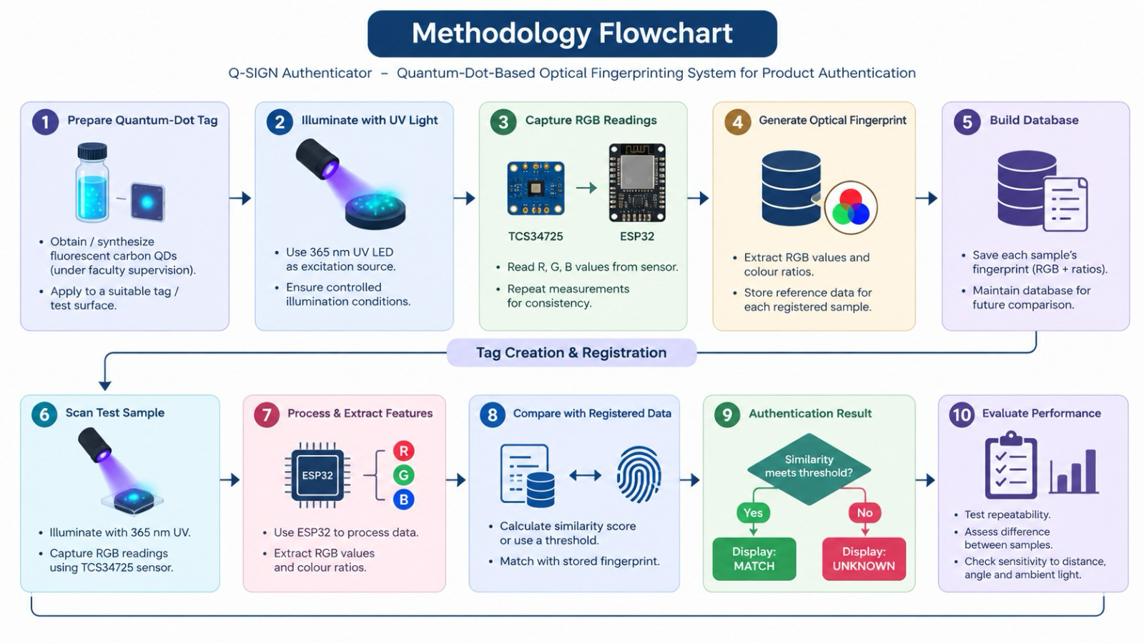
Notes:
Rohan

Slide 14
Time Line
•Weeks 1–2 | Initiation: Finalize the research question, review literature, confirm component availability and agree on safe sample materials.
•Weeks 3–4 | Planning: Complete circuit and enclosure design, prepare a detailed BOM, assign team roles and define the measurement protocol.
•Weeks 5–6 | Build: Assemble LED, sensor, ESP32 and OLED; test communication and create a light-shielded housing.
•Weeks 7–8 | Software: Develop sensor-reading firmware, CSV logging, feature extraction and reference matching.
•Weeks 9–10 | Experiments: Collect repeated readings; test multiple samples, distance, angle and ambient-light effects.
•Weeks 11–12 | Analysis: Calculate repeatability and sample separation; document failure cases and revise thresholds if justified by the data.
•Week 13 | Final review: Prepare final demonstration, report, presentation and recommendations for future work.
Notes:
Ratnasree

Slide 15
Proposed Outcomes
Expected results:
- A working prototype: a CQD-tagged product plus a UV scanner (UV LED + RGB sensor + ESP32) that gives an instant MATCH / NO MATCH verdict on the OLED.
- A dataset of tag readings with a performance report.
- Genuine tags accepted, while imitation tags (ordinary fluorescent dye, printed copies) are rejected with accuracy of at least 60%
Potential Impact on the Field :
-Harder to fake than QR codes/ bar codes
-low cost
-practical for supply chain and IoT ready
Future research directions:
Anti-copying measures, database security, addition of PUF need future research/work .
Notes:
Ratnasree

Slide 16
Conclusion
Summary:-
- Counterfeits can be cloned or re-stuck because barcodes, QR codes, RFID tags and holograms are copyable.
- The QD-based authenticator tackles this with a carbon quantum dot tag that has a measurable optical fingerprint.
- A low-cost UV LED + RGB sensor + ESP32 reader compares each scan with a stored profile and shows MATCH / NO MATCH.
Final thoughts:
Aim: show that affordable optical sensing can support a useful physical-digital tag identity.
Limits: RGB sensing is not spectroscopy, responses may vary with conditions, and a match alone cannot prove product genuineness.
Next steps: Material validation → scanner build → data collection → software → evaluation.
Notes:
Ratnasree

Slide 17
References
https://pubs.rsc.org/nr/article-abstract/17/36/20865/901807/Advances-in-semiconductor-quantum-dot-based
https://pmc.ncbi.nlm.nih.gov/articles/PMC13122586/
https://ieeexplore.ieee.org/abstract/document/10915375
Highly bright carbon quantum dots for flexible anti-counterfeiting.
Journal: Journal of Materials Chemistry C Read on ResearchGate
Notes:
Ratnasree

Slide 18


